Slide 1

Lecture 6 - Architecture Styles Part 1

Slide 2

Architecture

Slide 3

Today’s Topics
Architectural Styles
Monolithic
Client-Server
Multi-Tier Models
Representational State Transfer
Peer-to-Peer

Slide 4
Key questions
How do we decompose a system into components?
How are components classified?
Is there a logical flow to the components?
How is the architecture deployed?
How does the architecture respond to change?
Is the architecture extensible?
How maintainable is the architecture?

Slide 5

Important Note
Real systems, especially large ones, rarely use one particular architectural style
Often a hybrid approach
When looking at real software, you can identify several architectural styles mixed together
e.g Skype combines Client-Server with Peer-to-Peer
In this course, we are only covering each architectural style with broad strokes
Each individual style could probably have an entire course about it

Slide 6

Monolithic
Monolithic architecture describes a single-tiered software system that combines all the software’s requirements into a single platform
Monolithic software is self-contained, where a single application oversees the entire functionality of the Software
User interface, business rules and data access are all combined
Note: monolithic applications can still be decomposed into smaller parts but these are all still rolled into a single application
No conceptual decomposition into multiple independent components

Slide 7
Monolithic example
Example: Microsoft Word
User interface (typing, inserting images, etc.), business rules (when to break lines, how text should wrap around images, etc.), and data access all combined into a single application
All deployed to a single device
Code isn’t conceptually separated into multiple independent components
Other examples
Old financial systems
Many simple video games

Slide 8

Monolithic example
Pros
Easy to develop
Easy to deploy
Cons
Codebase is harder to understand as time passes
Large size can decrease performance
Difficult to maintain and change
Can improve modularity by using multiple files
Difficult to scale
Can only scale one dimensionally via running multiple copies
Forces developers to commit to certain technology
Hard to swap out components at a later point

Slide 9
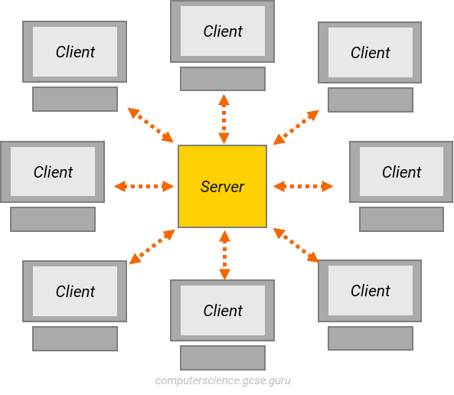
Client-Server
Client-Server architecture divides the functionality of a software system into two conceptual parts
A server provides resources or services and listens for requests
A client requests resources of services
By separating the client and server, we introduce a layer of abstraction
The client does not know/care how the server does something
For the client, server is a black box

Slide 10

Client-server
Servers may implement an application programming interface (API) to restrict the format of messages passed between client and server
One server may typically accommodate multiple clients, requiring some kind of scheduling system
Client-Server architecture actually describes a family of architectural styles, all focused on dividing a software system into multiple layers or tiers

Slide 11
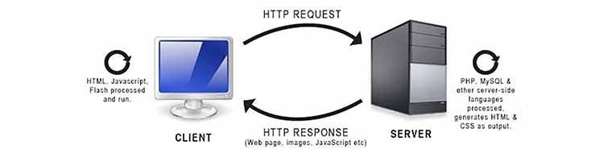
Client-Server
Example: A simple website
The user’s web browser is a client
The web server that hosts the site is the server
Requests and responses happen via HTTP/HTTPS

Slide 12

Important Note
Pros
Separation of concerns
Scalability
New clients and servers can be added
Servers can be upgraded to improve performance, storage size, etc
Centralised control allows for tighter security and easier development
Clients and servers can be deployed anywhere
Cons
Can be difficult to manage traffic
Server failure can result in the entire system failing
Maintaining servers can be costly

Slide 13
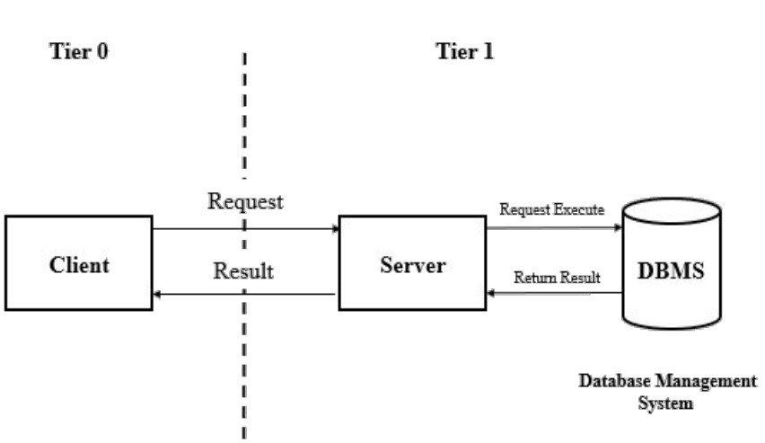
Multi-Tier Architecture
Client-Server architecture actually describes a family of architectural styles, all focused on dividing a software system into multiple layers or tiers
The prototypical client-server model is a 2-tier model
Client handles presentation
Server handles logic and data

Slide 14
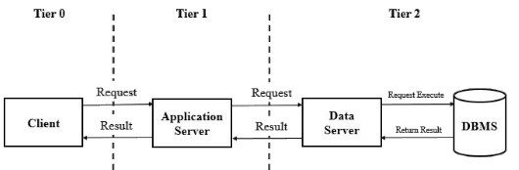
Multi-Tier Architecture
The client-server model can be extended to a 3-tier model, divided into three layers
Presentation tier: handles user interface
Application tier: handles the logic of the system
Data tier: handles the storage and retrieval of data
3-Tier Example: Web applications
Presentation tier: content presented to the user, typically rendered by the client’s browser
Application tier: middle-layer software that processes content and handles client requests
Data tier: back-end database and database management system

Slide 15
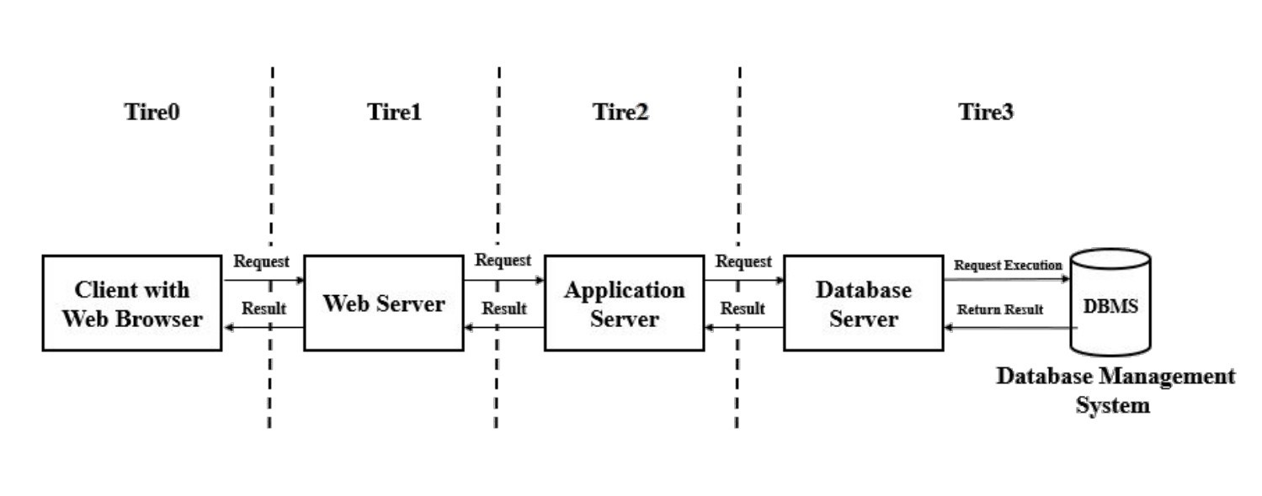
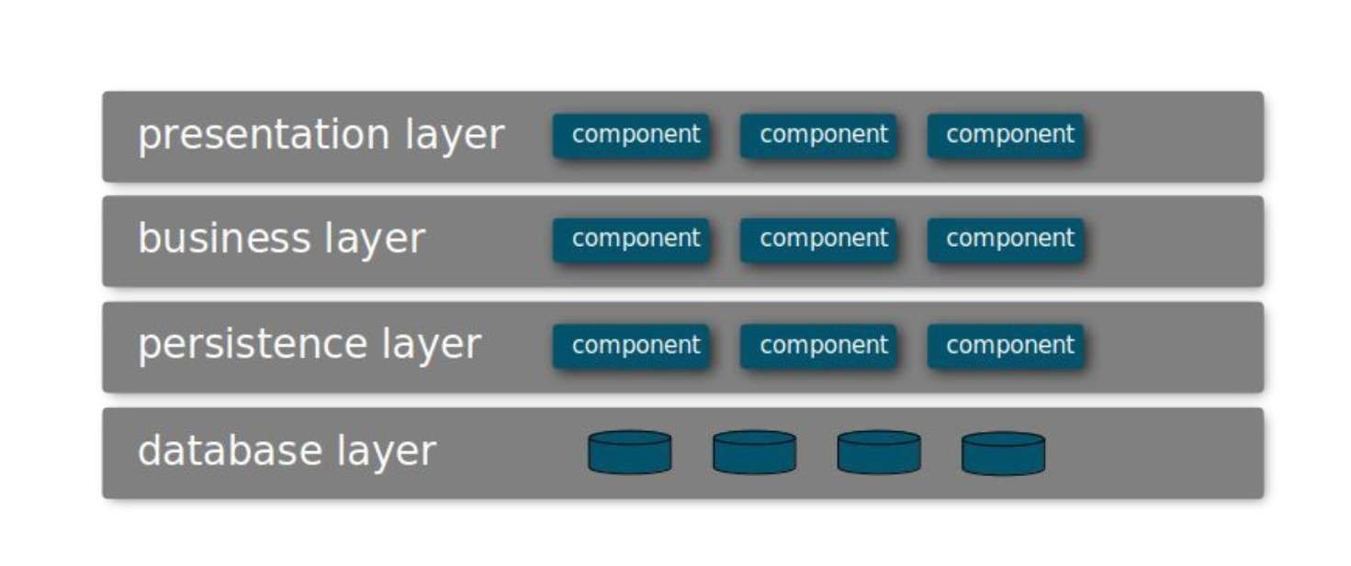
Multi-Tier Architecture
distinct layers
The 3-tier model can be generalised to an n-tier model, consisting of n distinct layers
In n-tier systems, the naming conventions for layers vary more than in the 3-tier model
Presentation layer: handles user interface, etc
Business layer: handles business rules and middle-layer services
Sometimes split into the business layer and application (aka services) layer
Persistence layer: handles access to data, logging, etc.
Database layer: handles data
Layers are isolated, meaning changes in one layer generally don’t impact or affect components in other layers

Slide 16
Principles of Multi-Tier Architecture
1. Layers are isolated: meaning changes in one layer generally don’t impact or affect components in other layers

Slide 17
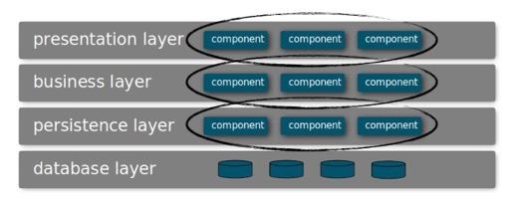
Principles of Multi-Tier Architecture
2. Separation of concerns: components within a specific layer deal only with logic that pertains to that layer

Slide 18
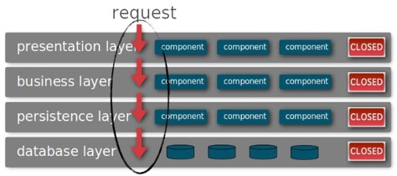
Principles of Multi-Tier Architecture
3. Layers are closed, meaning layers can only interact with the layer above or below them
i.e. Requests move from layer to layer

Slide 19
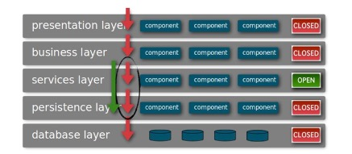
Principles of Multi-Tier Architecture (Variants)
Variant: open layers allow communications to skip that layer

Slide 20
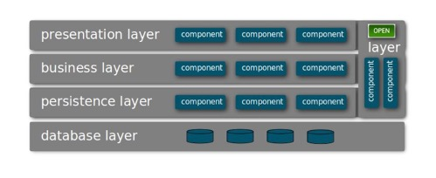
Principles of Multi-Tier Architecture (Variants)
Variant: specific components can interact with components in multiple layers, forming their own layer

Slide 21
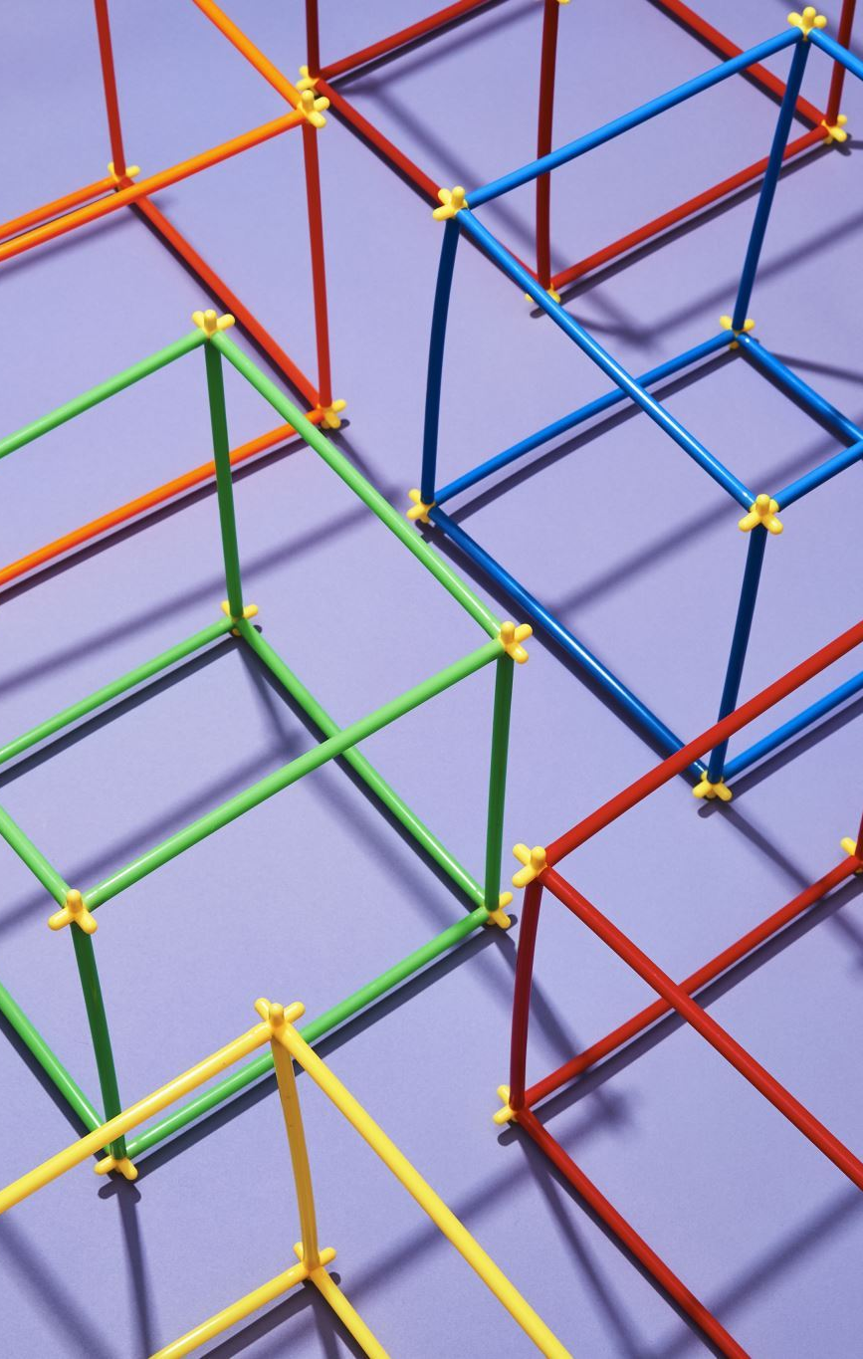
Multi-Tier Architecture
Pros
Allows for greater scalability
Separation of data tier/layer improves security and data integrity
Easier to maintain and upgrade due to isolation and separation of concerns  Easy to test due to isolation  Dummy layers can be used
Cons
Dividing system into layers can be difficult to design and implement
Adding too many layers can increase complexity
The architecture sinkhole: requests flow through multiple layers with little or no processing occurring between layers
Without careful management of layers, layered systems can drift into monolithic architectures

Slide 22

REST
Representational State Transfer is an architectural style that standardises web systems
Web services that conform to REST are RESTful
REST builds on the Client-Server architecture

Slide 23

REST
The six constraints of REST:
1)Client-Server architecture – enforces separation of concerns, allows for clients (e.g. browsers) and servers to evolve separately
2)Statelessness – session information is not retained by the server. Every request can be understood in isolation
3)Cacheability – clients and intermediaries (e.g. proxy servers) can cache responses. Servers need to define whether or not responses are cacheable
4)Layered system – clients cannot tell if they are connected to the end server or an intermediary (e.g. proxy servers or load balancers)
5)Code on demand (optional) – servers can extend the functionality of clients by transferring executable code (e.g. JavaScript)
6)Uniform interface – standardised interface for requests and responses

Slide 24

REST
The uniform interface constraint is made up of four key requirements:
1) Resource identification in requests – individual resources are identified in requests (e.g. using URIs). A representation of a resource may be returned to the client (e.g. JSON, HTML, etc.) rather than the resource itself.
2) Resource manipulation through representations – the representation of the resource returned to the client has enough information for the client to manipulate that resource (e.g. modify, delete)
3) Self-descriptive messages – messages contain the information required to process them (e.g. the type of file)

Slide 25

REST
Example: An HTTP-based RESTful web application
Resources identified using URIs
e.g. http://example.webapplication.com
Responses defined by media types
e.g. application/json, image/png, etc
Requests use HTTP protocol
GET requests fetch a representation of a resource
POST requests attach a representation that the resource can process
PUT requests replace the target resource with the attached representation
DELETE requests delete the target resource

Slide 26
Multi-Tier Architecture
Example: An HTTP-based RESTful web application
Safe – method does not change the server’s state
Idempotent – using the method multiple times on a resource is equivalent to using the method once
Cacheable – responses can be cached for future reuse
HTTP Request | Safe | Idempotent | Cacheable
GET | ✓ | ✓ | ✓
POST |  |  | ✓
PUT |  | ✓
DELETE |  | ✓

Slide 27
Quick Recap
The client-server model describes a system where one part requests a resource or service and another part listens for and responds to requests
The client-server model is the basis for a number of multi-tiered models , where each layer acts as a client for the layer below it and as a server for the layer above it
REST describes a particular type of client-server model designed for the web, defined by a number of architectural constraints

Slide 28

Peer-to-peer
Peer-to-peer architecture distributes tasks between equal participants, known as peers
Contrast with Client-Server, which distributes tasks unequally between clients and servers
Peers make their resources available to other peers in the network without any central coordination. Peers in the network are both suppliers and consumers.

Slide 29
Peer-to-peer
In pure P2P architectures, also known as unstructured P2P, no structure is imposed on the network. Instead, peers randomly form connections with each other.
Peer contacts all available peers to find the resource it wants, with each of those peers passing on the request if they cannot fulfill it
Examples: Gnutella
With Gnutella, each peer needs to know of another peer to join the network

Slide 30
Peer-to-peer
Pure P2P
Pros
Easy and cheap to set up and maintain
No central point of failure  System performance scales with users
Cons
Flooding ((peers sending out queries to everyone in the network) increases network traffic and load on each peer
Security is much harder to manage
Lack of centralisation makes content availability and keeping backups harder
Harder to control (eg: illegal content)

Slide 31
Peer-to-Peer
Hybrid P2P architectures combine P2P and Client-Server architectures
e.g. using a central server to help peers find each other (eg: bittorrent)
e.g certain functionality uses P2P, other functionality uses Client-Server (eg: Skype and some multiplayer games)
Hybrid P2P reduces the impact of flooding

Slide 32
Peer-to-peer
Case study: Bittorrent
Peer A wants to download a resource
Peer A contacts the tracker and declares what it’s looking for
Tracker helps the peer A find other peers with the resource
Using a piece selection algorithm, peer A requests a small piece of the resource from each available peer
Maximises typically low upload speed
Meanwhile, peer A can now share any of the pieces it has with other peers

Slide 33
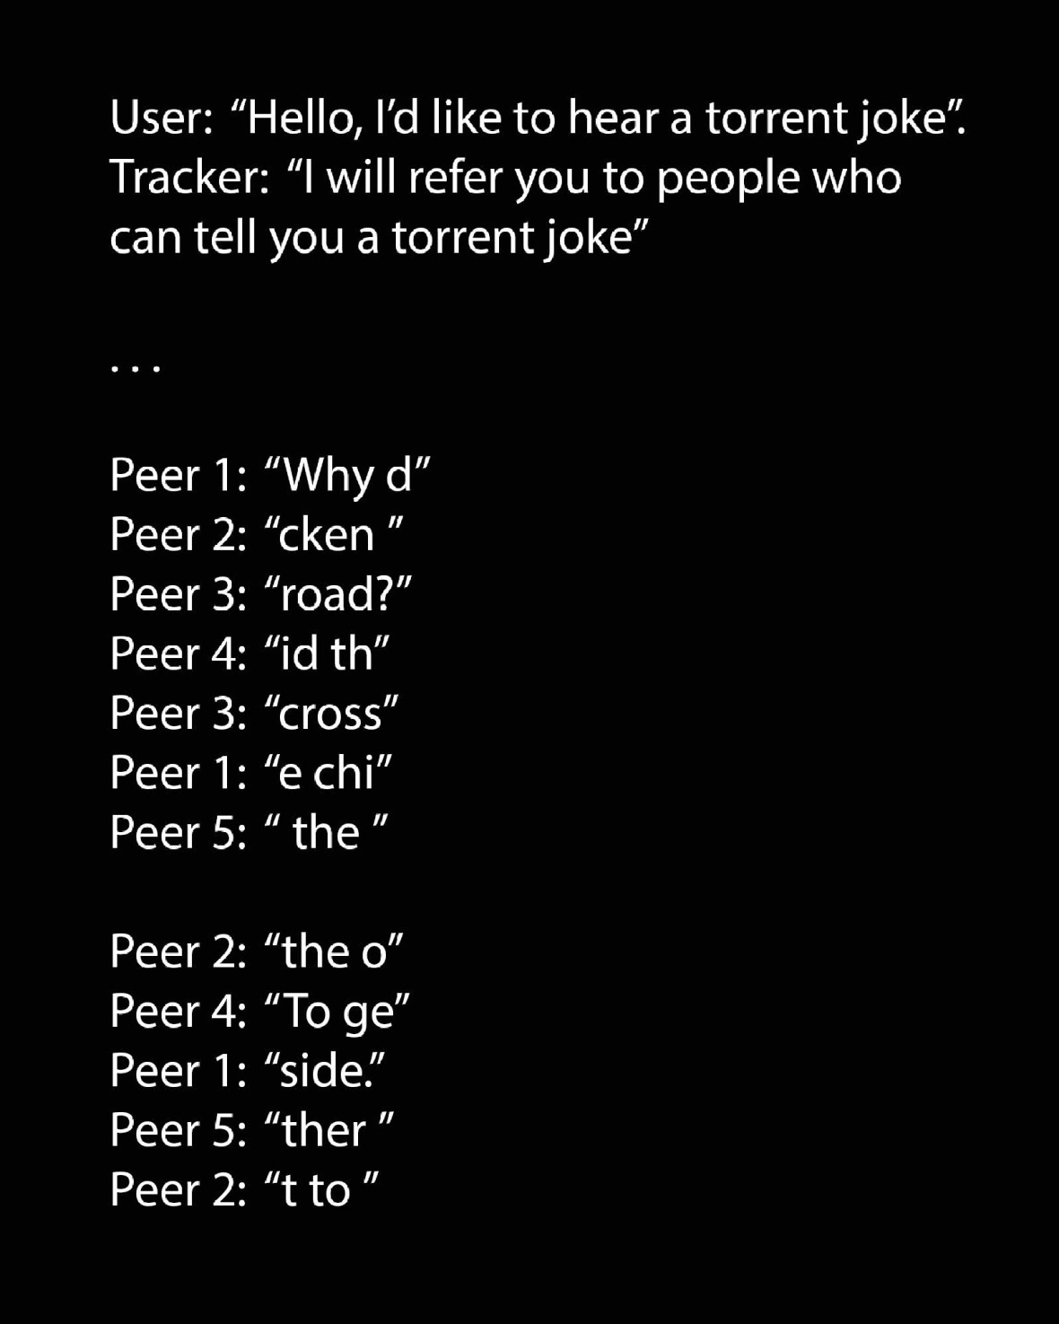
Peer-to-peer
Much more to P2P…
Structured P2P using distributed hash tables
Cooperative networking
Strategies to prevent choking
etc

